Slide 1
Algorithms and Data Structures TEB1113/TFB2023 - may 2025
LAB TA: Reeyan afzaL

Slide 2

LAB – 7 trees - i

Slide 3
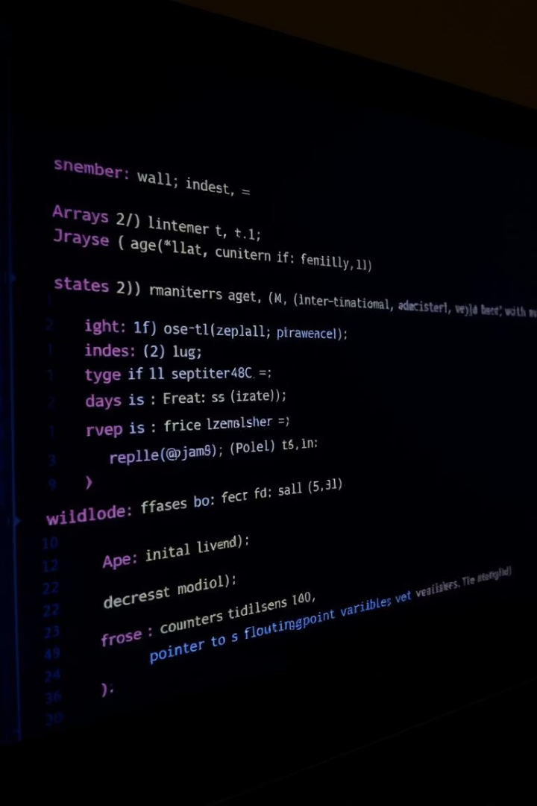
Objectives for lab-7
Learn to implement a tree ADT using an array.
Ability to implement a tree ADT using a Linked List.
Learn to implement various tree traversal methods.
Develop the ability to use an appropriate tree data structure to solve real-world problems.

Slide 4

Brief history
The tree is a non-linear data structure in which data is stored hierarchically. A tree can be defined as a finite set of one or more nodes such that:
There is a specially designated node called the root.
The remaining nodes are portioned into 𝑛 ≥ 0 disjoint sets 𝑇1,…, 𝑇𝑛, where each of these sets is a tree. 𝑇1,…, 𝑇𝑛 are called the subtrees of the root. For example, in the below tree, A is a root node, and the node within the orange circle is a subtree of A. Similarly, {C, G} and {D, H, I, J, M} are two other subtrees of root A.

Slide 5
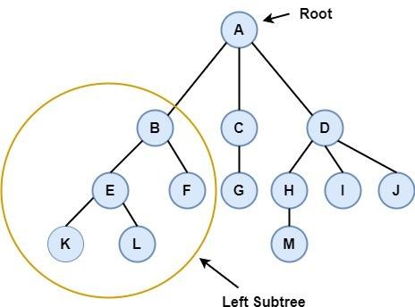
Brief history

Slide 6
Tree terminologies
Edge: In a tree data structure, the connecting link between any two nodes is called an edge. In a tree with 'N' number of nodes, there will be a maximum of 'N-1' number of edges.
Parent Node: If N is an immediate predecessor of a node X, then N is called the parent of X. In the above tree, A is the parent node of B and C.
Sibling: Nodes that belong to the same Parent are called siblings. E and F are siblings in the above tree.

Slide 7
Tree terminologies
Internal Node: In A data structure nodes which have at least one child is called an internal Node. A, B, C, D, E, F, G, H, I, J are the internal nodes in the above tree.
Level: The number of edges present in a path from a node to the root is called the level of that node. The level of a root is zero, if a node is at level 𝑙, its children are at level 𝑙 + 1. For example, the level of node H is 2.
Height: In a tree data structure, the total number of edges from a leaf node to a particular node in the longest path is called as height of that particular Node. The height of H is 1.

Slide 8
Tree traversal
Visiting every node of the tree exactly once is known as traversal. Any hierarchical data structure, like a tree, can be traversed in different ways.
The tree can be traversed in three ways;
In order traversal, which for every node first left subtree is visited then the root, and then the right subtree is visited.
Pre-order traversal in which for every node, first the root then the left subtree then and then the right subtree will be visited,
Post Order traversal in which the first left subtree, then the right subtree, and then the root will be visited.

Slide 9
Binary Tree
Binary tree is a special kind of tree in which every node can have at most two children.
A binary tree can be represented either using an array or a linked list.
For array representation, if a root node is stored at array index 𝐼, then its left child will be stored at index 2 × 𝐼 and the right child will be stored at index 2 × 𝐼 + 1.
For a linked list representation, along with data fields, every node will contain two pointers, one will be linked with the left child, and another will be linked with the right child.

Slide 10
Lab-task
Tree representation.
Binary tree implementation.
Implementation of different tree traversal algorithms.
Inserting new elements, deleting existing elements, and updating elements in tree.

